Slide 2
Livable Buckhead, Inc.
Mission:
Livable Buckhead, Inc. strives to ensure the long term vitality and prosperity of the Buckhead community by working cooperatively with individuals, public entities and private businesses to integrate into everyday life and business sustainable strategies that improve the environment and quality of life in the community.
Programmatic Overview:
Sustainability
Resource Conservation
Social and Cultural Vibrancy
Access + Mobility
Greenspace
Public Health and Safety
Housing
Innovation

Slide 3
Leadership
Executive Committee
Chairman – Bob Stoner
Secretary – Sally Silver
Treasurer – Sandy Godwin
Staff
Exec Director - Denise Starling
Client Accounts Mgr – Scott Cantrell
Business Development Mgr – Tony Peters
Office Manager – Sara Cuomo
Program Administrator – Calvin Cromer
Outreach Manager – Tom Bastek
Board of Directors
AGL Energy Services – Kathy Robb
Cousins Properties – TBD
Parsons Brinckerhoff – Pat Corletto
Gables Residential – Dave Skelton
Lowe Engineers – Tim Lowe
Morris Manning & Martin – Greg Chafee
Neighborhood Planning Unit B – Sally Silver
Pearl Meyer – Sandy Godwin
Piedmont Hospital – Holly Snow
The Mansion Hotel - Mica Hill
10 Terminus – Diane Belk

Slide 4






Mobility Services
  Through sister organization, BATMA, LBI works cooperatively with community partners to improve mobility, accessibility and air quality in Buckhead by sponsoring programs and providing incentives to encourage commuters to take transit, carpool, vanpool, telework, bike and walk to work.
Over 80+ businesses
Over 20 property management firms
Over 3,000 commuters
Several Partner organizations

Slide 5
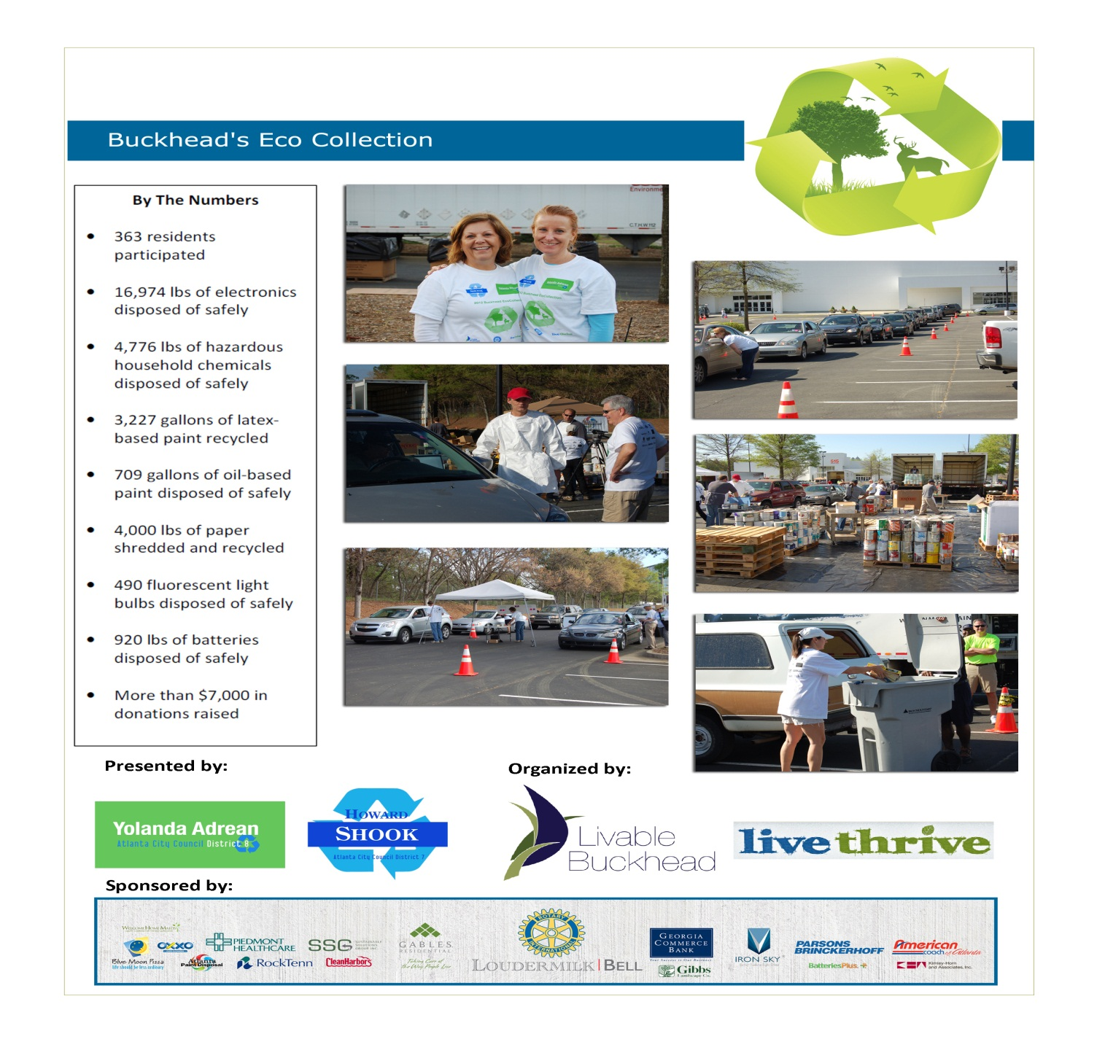
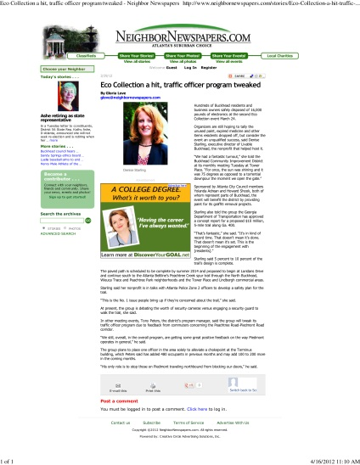
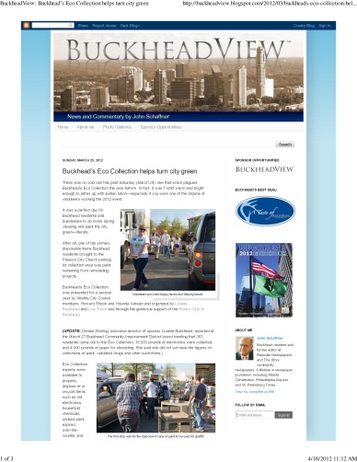
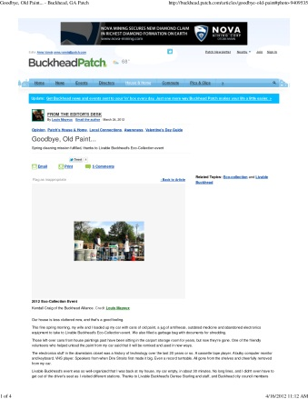
Hazardous Waste Collection
For
Residents

Slide 6

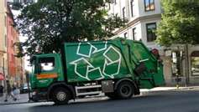
Recycling- Commercial
Community-wide Recycling Initiative:
Community-wide waste management initiative focused on commercial properties
Uniform recycling criteria throughout the community
Right-Size current operations
Leverage collective buying power to procure for
recycling and waste hauling services
Divert recyclable materials from landfills
Measurement
Partners:
  Atlanta Financial Center - Alliance Center
  Marriott Courtyard - Piedmont 14
  Monarch Tower - Tower Place 200
  Monarch Plaza - Resurgens Plaza

Slide 7
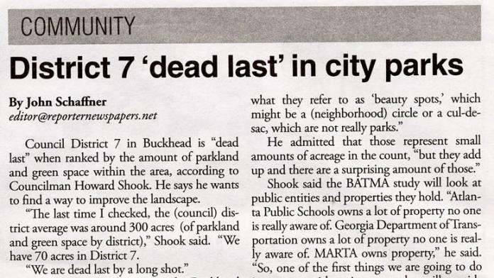
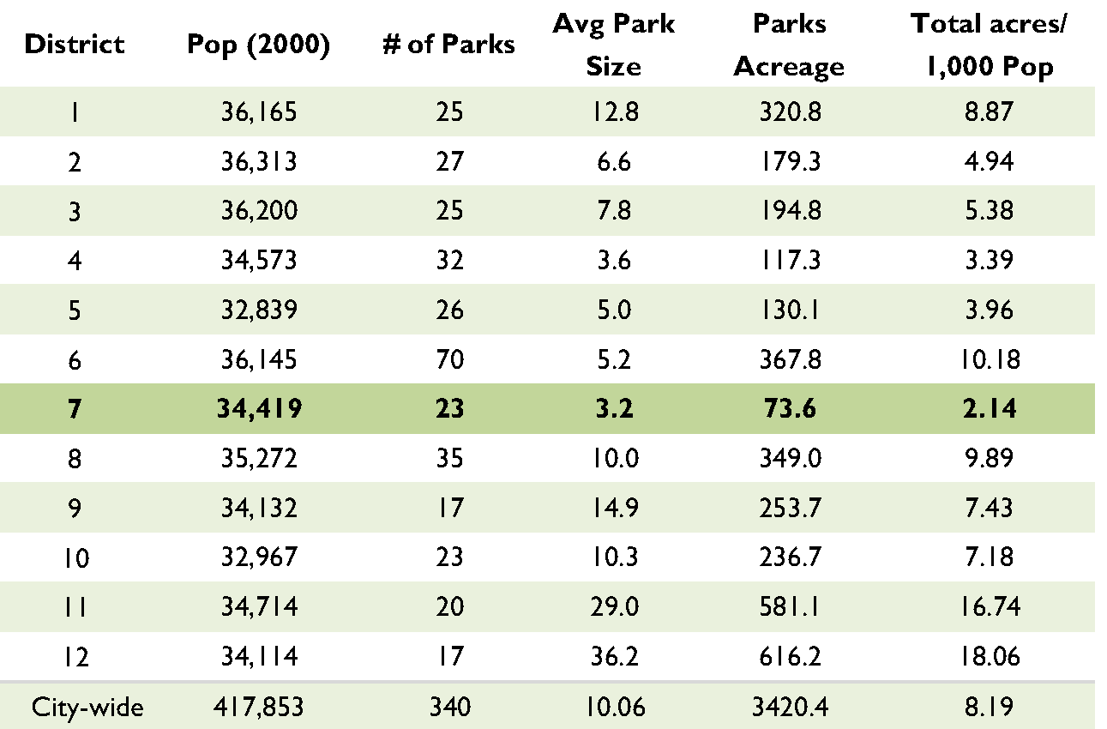
Greenspace

Slide 8
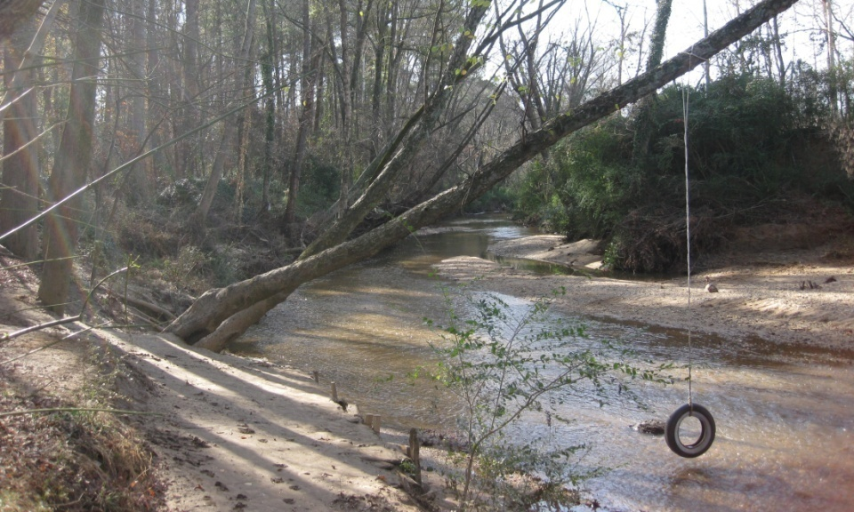
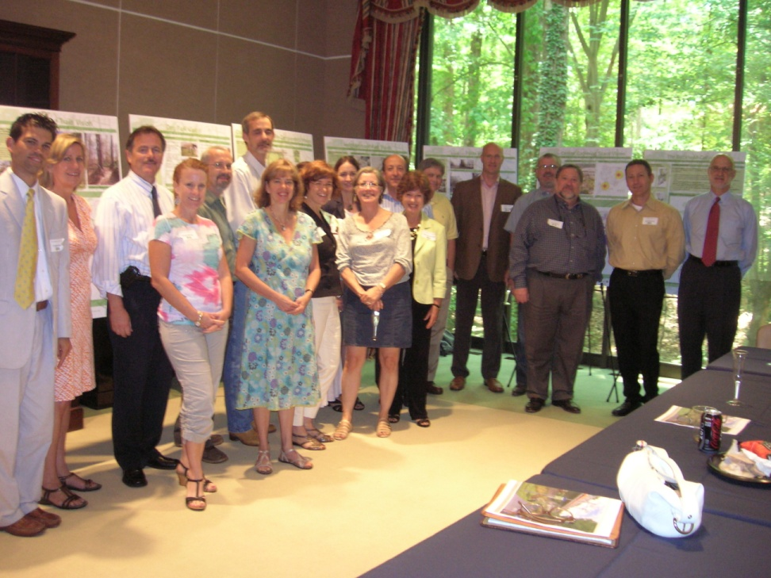
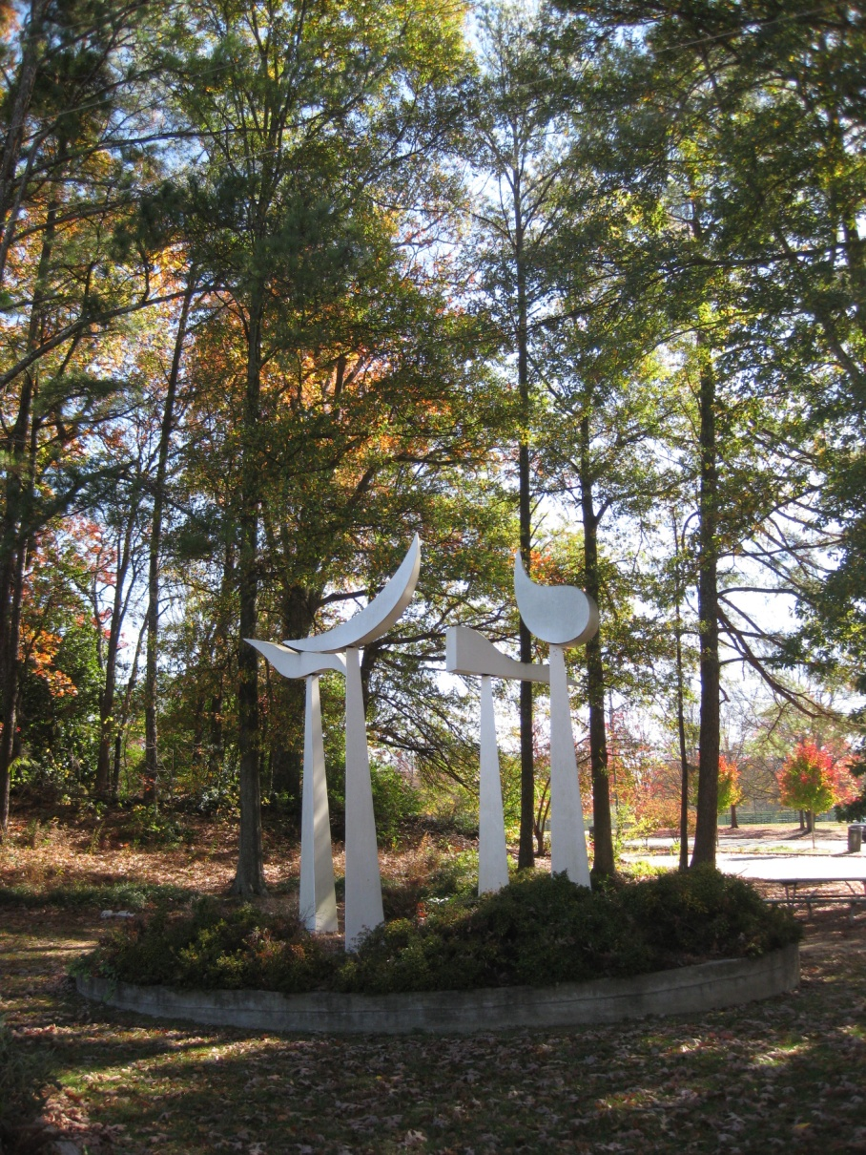
Greenspace Vision
Buckhead Collection:
Project Atlanta – Dead Last
Howard Shook impetus
CID /Coalition Supported, BATMA managed
Steering Committee:
  24 people
  All neighborhoods
  AIS
  History Center
  Commercial Developers
  Art Gallery Owner
Public Engagement :(surveys, interviews, websites , public meetings, presentations
Two Tracks: What and Who
Bucks on the Street: BBA Foundation Partnership
  Buckhead Heritage
  School Board
  COA Watershed
  COA Parks
  Invest Atlanta
  City Council
  NPU-B

Slide 9
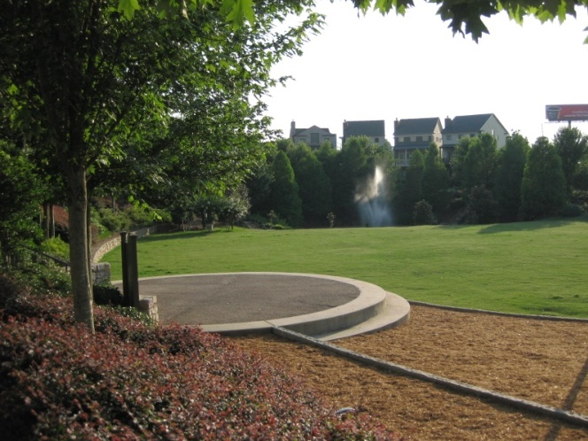
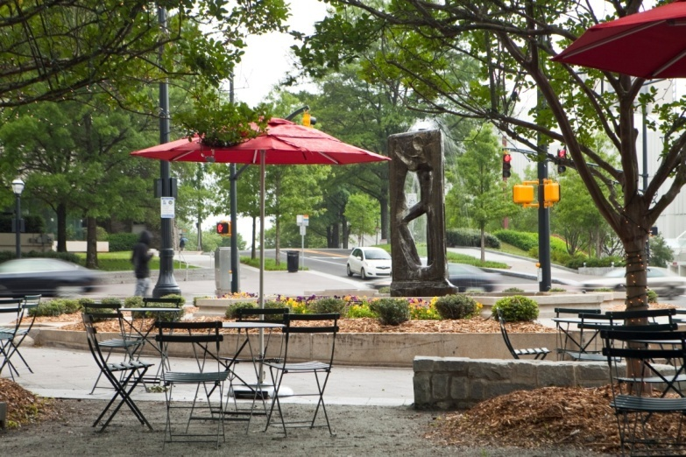
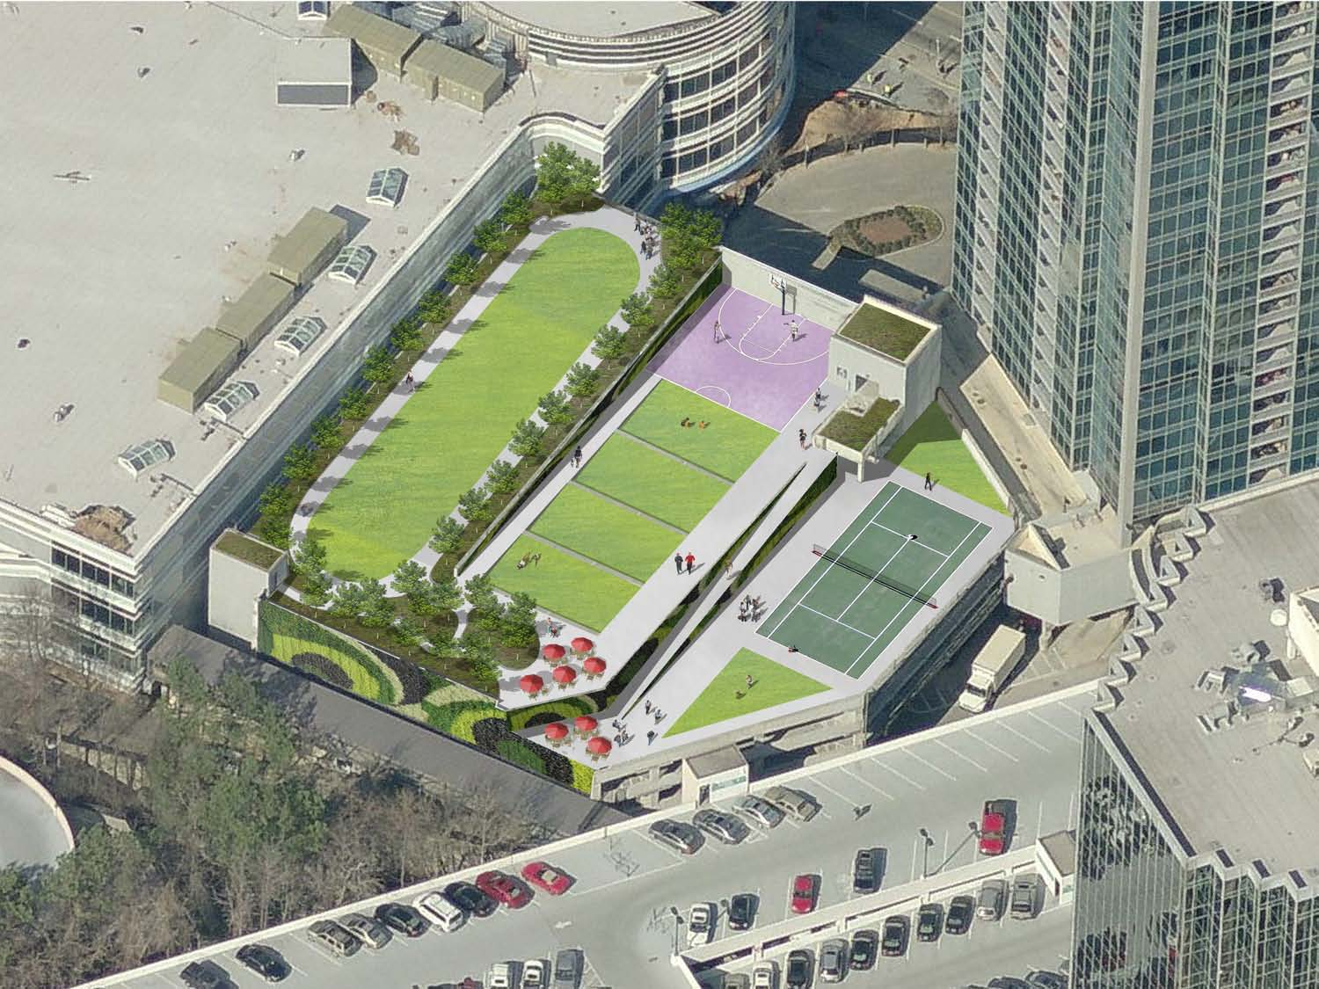
Buckhead
Collection
Civic Spaces
  Central Gathering Space
  Plaza
Neighborhood Parks
  Urban Neighborhood Park
  Suburban Neighborhood Park
Community Parks and Sports Facilities
  Community Parks
  Community Components
  Community Greens

Slide 10
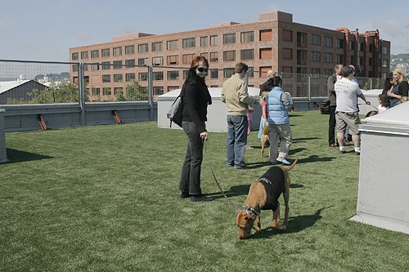
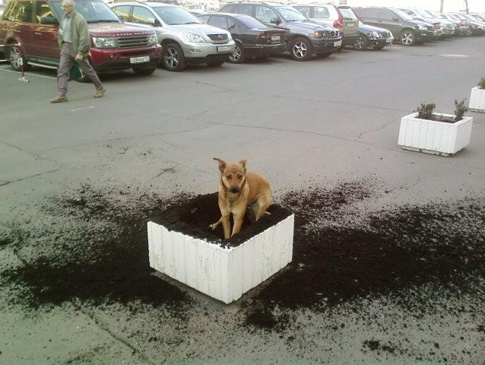
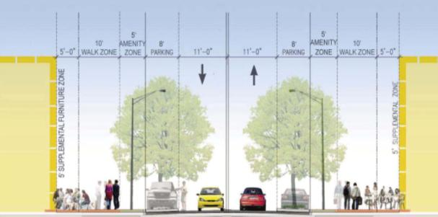
Buckhead
Collection
Dog Parks
  Dog Run
  Destination Dog Park
Conservation Parks
Trails + Greenways (Off-Street)
  Multi-Purpose Trail
  Nature Trail
Street + Sidewalks
  Boulevards
  Avenues
  Shared Street

Slide 11
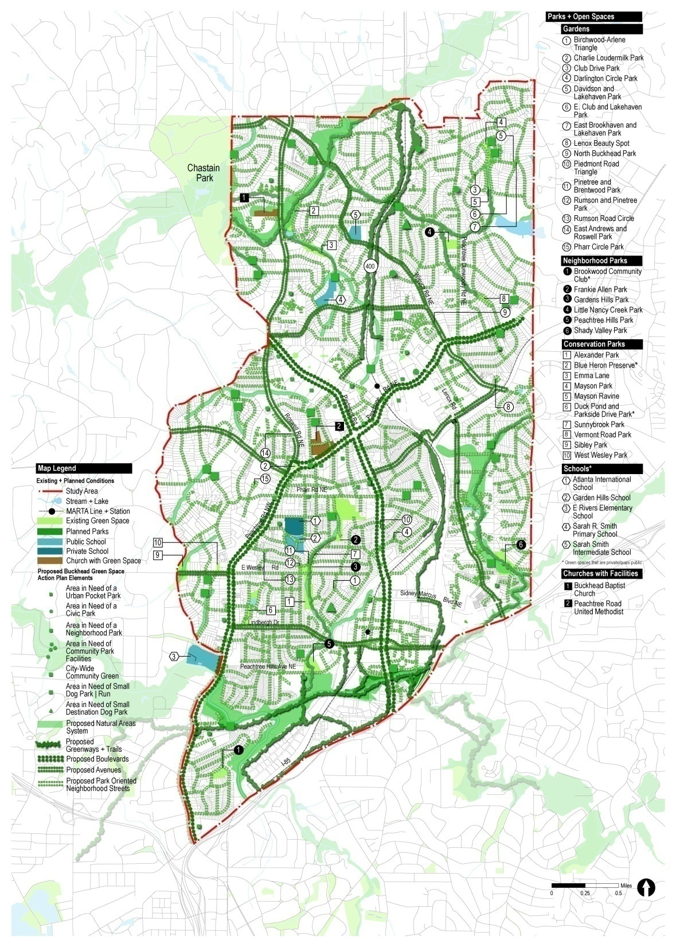
Buckhead
Collection Vision
16 Plazas + 0.3 Acres
2 Central Gathering Spaces + 4 .0 Acres
13 Neighborhood Parks + 19.5 Acres
3 Beltline Parks + 24.0 Acres
4 Comm Park Components + 3.5 Acres
17 Community Greens + 17 Acres
15 Dog Runs + 0.3 Acres
2 Destination Dog Parks + 2.0 Acres
Natural Areas + 9,300 Acres
Trails + Greenways + 36 Acres
Street + Sidewalk
Improvements + 20 Miles
Total Vision + 106.6 Acres

Slide 12
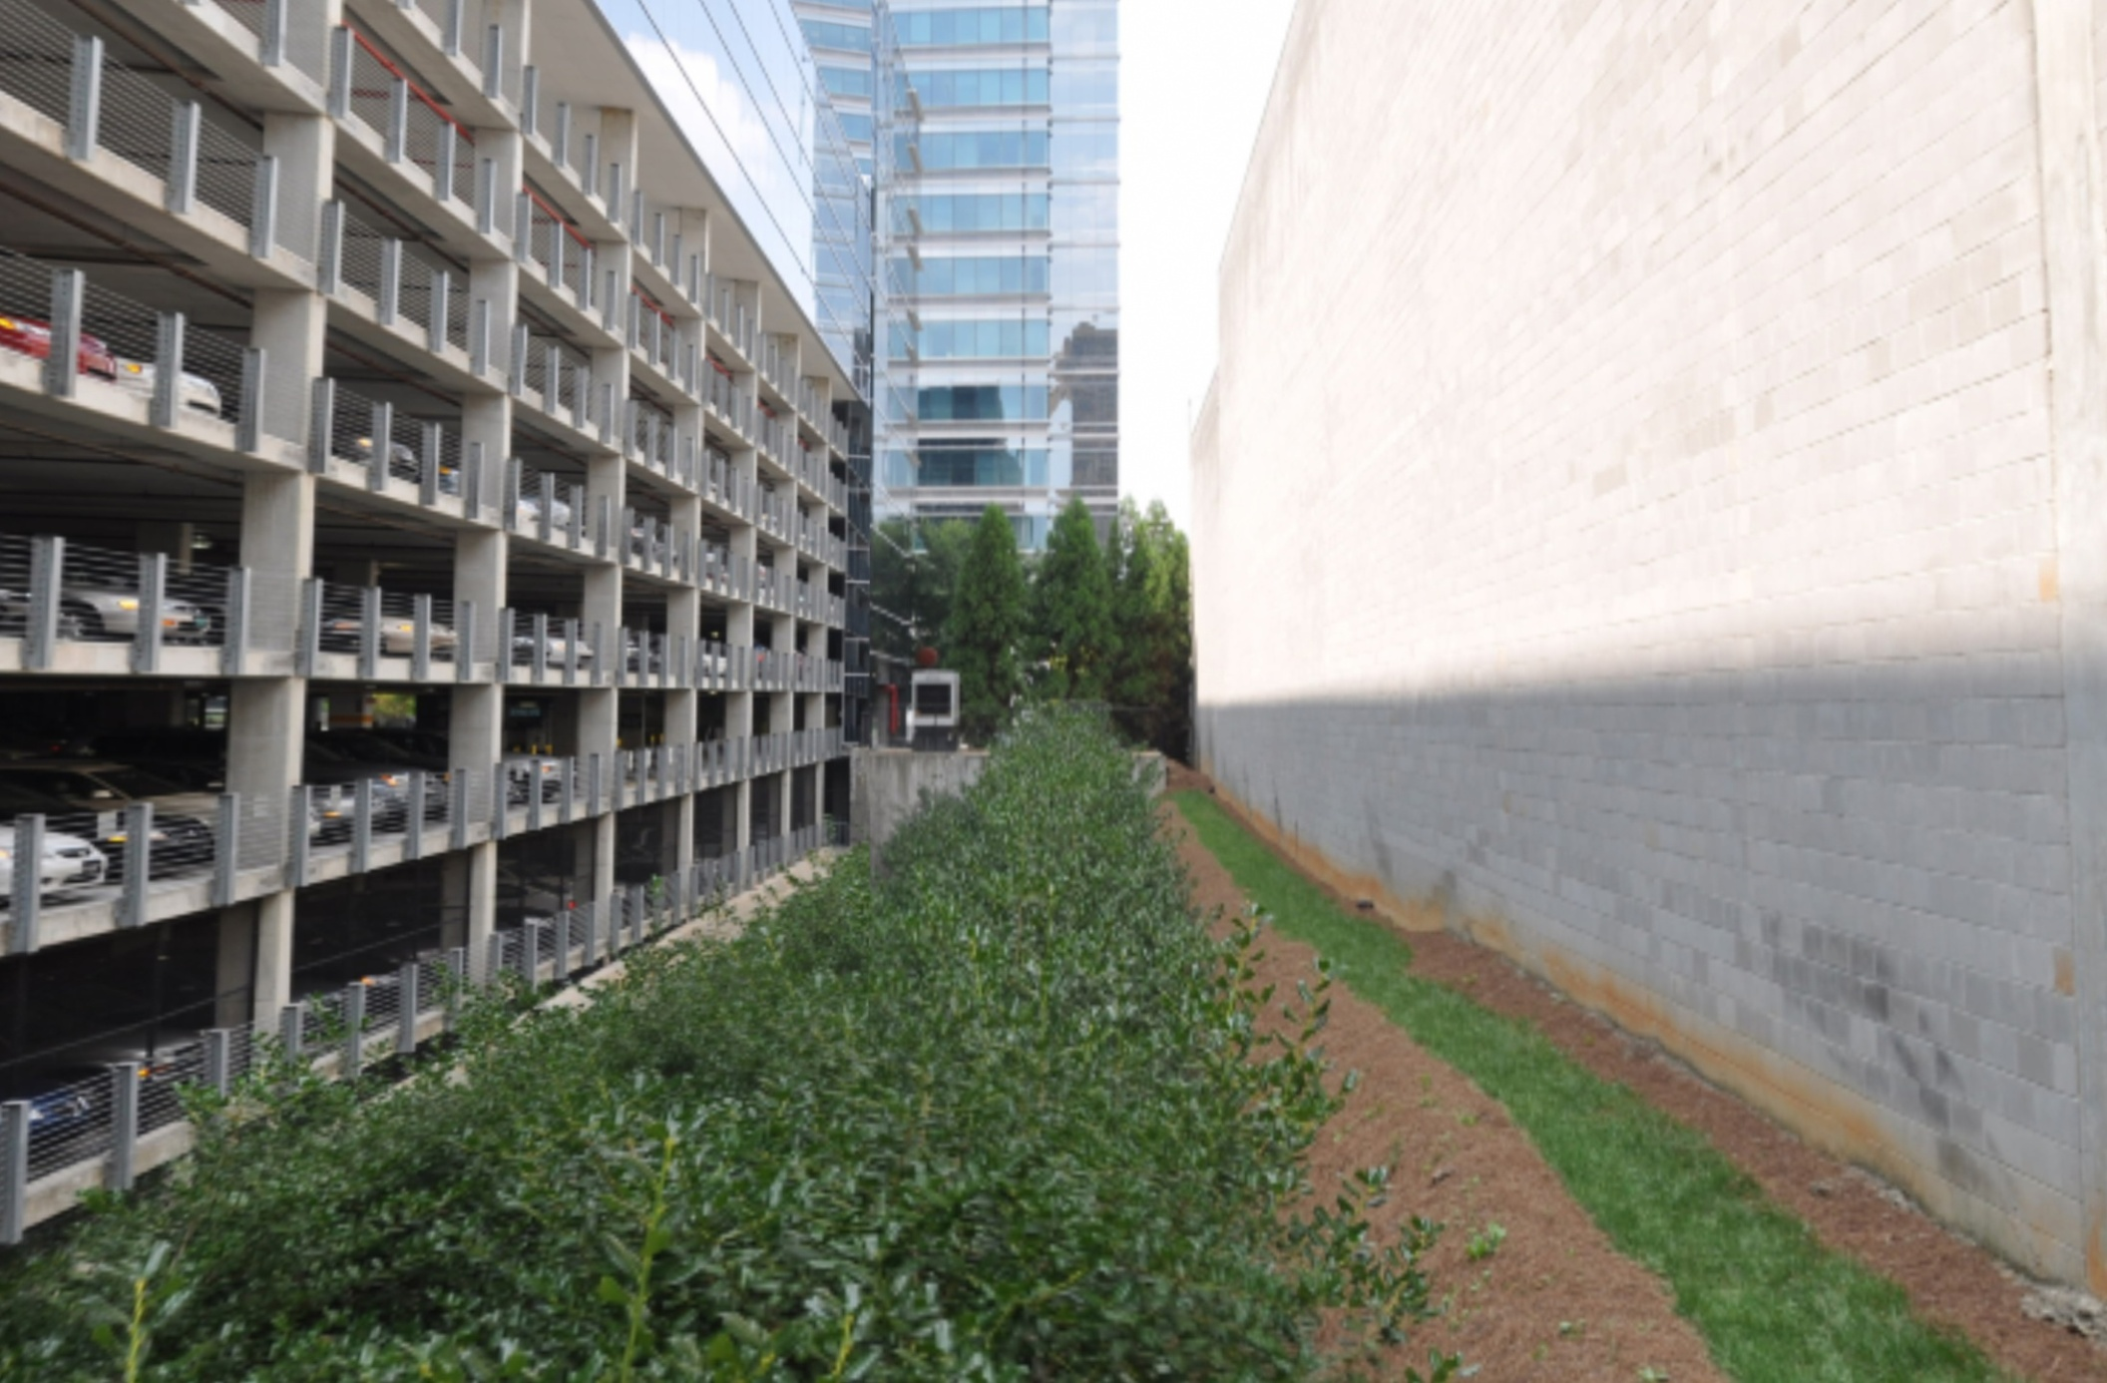
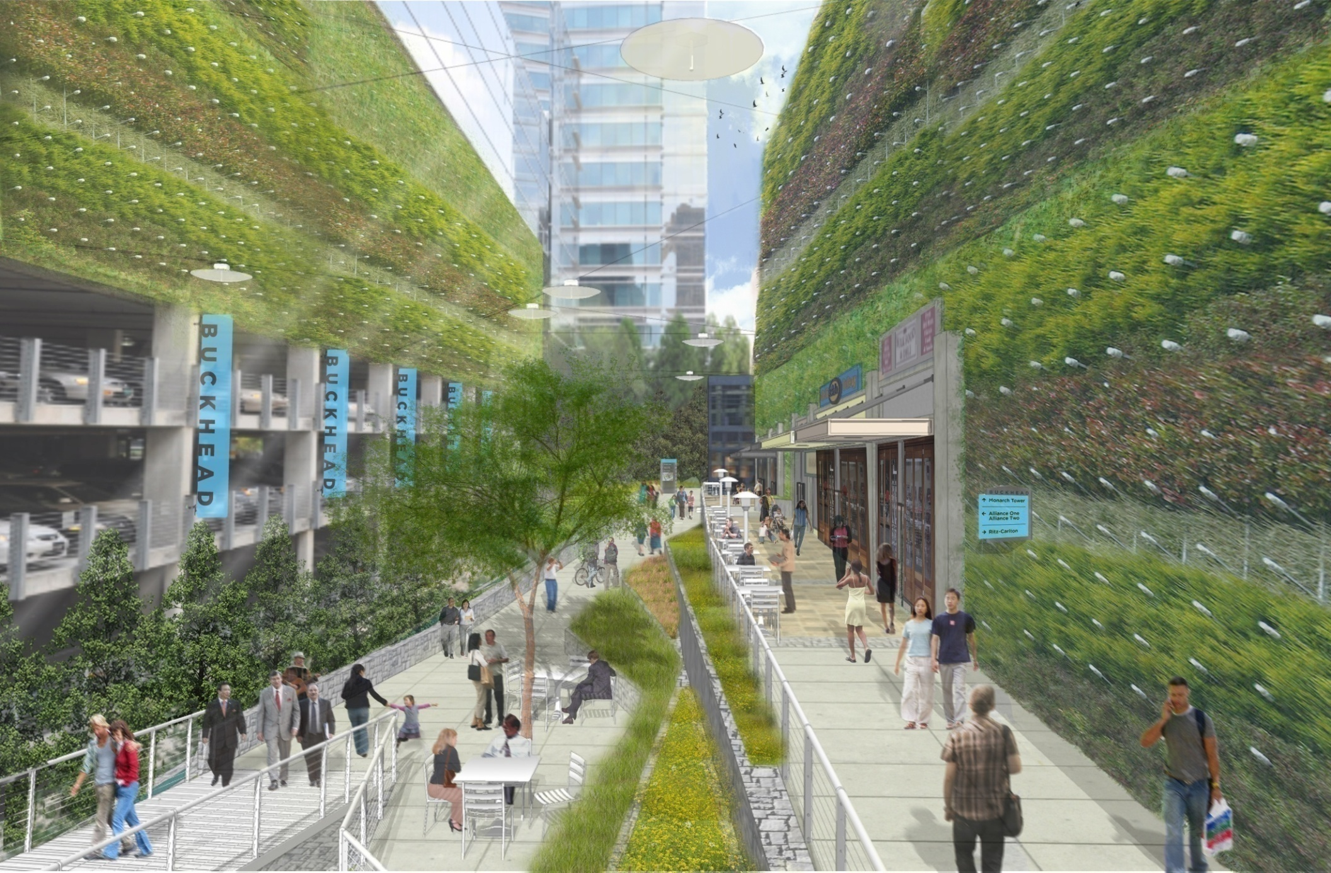
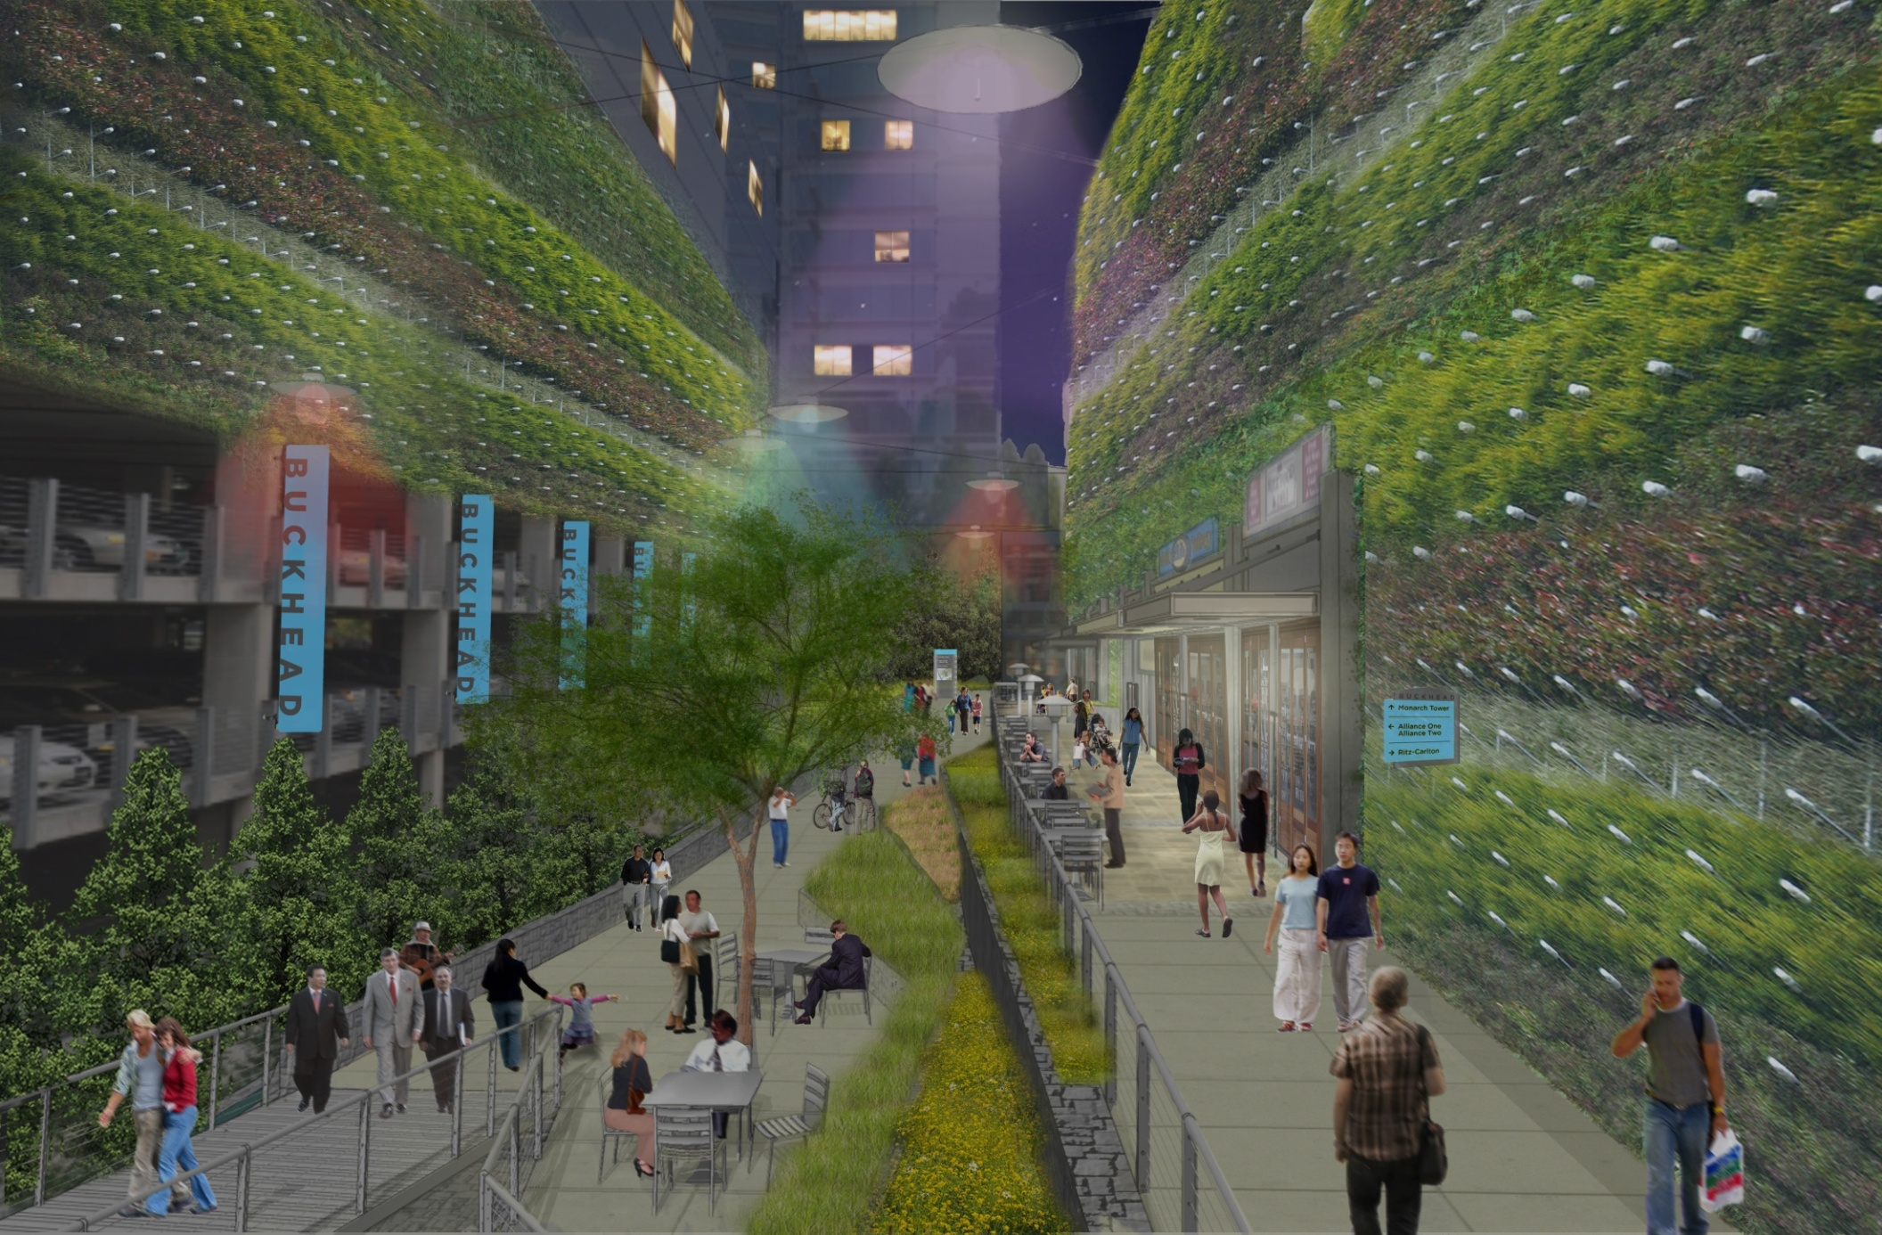
Pedestrian Connectivity

Slide 13

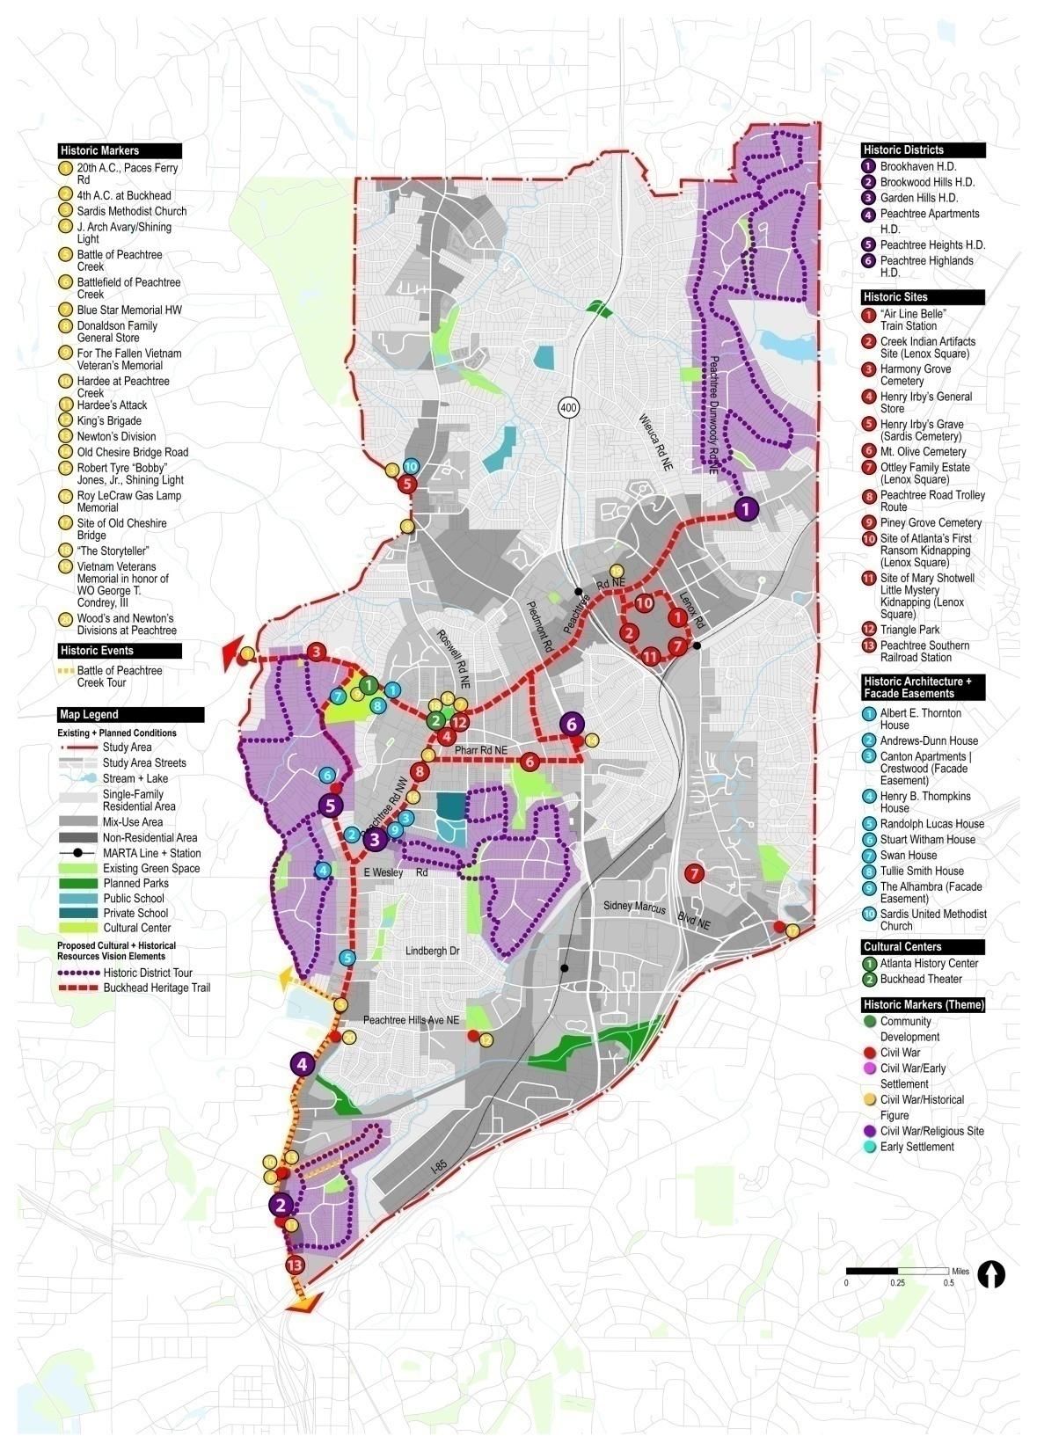
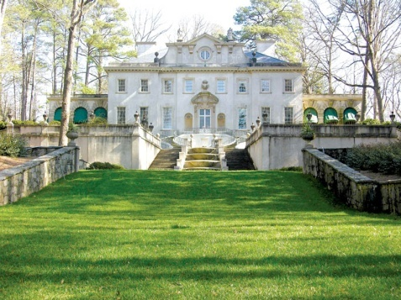
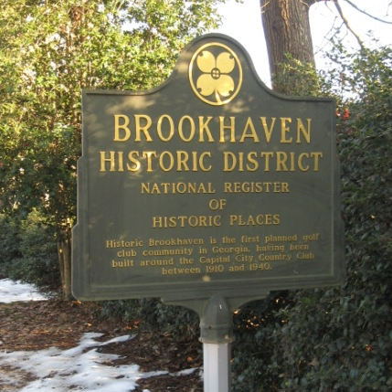
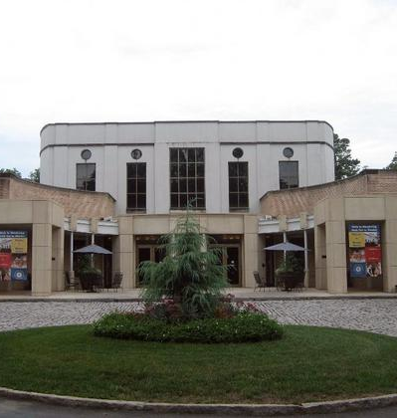
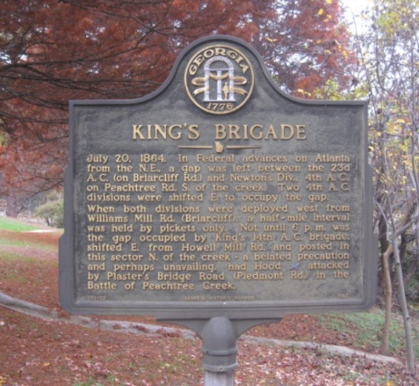
Interpretive
History Plan
Heritage Tourism is the fastest growing sector of tourism
Buckhead is rich in civil war, civil rights, architectural and development history
Telling our stories will attract visitors to stay through the weekends resulting in increased dollars to our local economy
Telling our stories reminds us of who we are

Slide 14
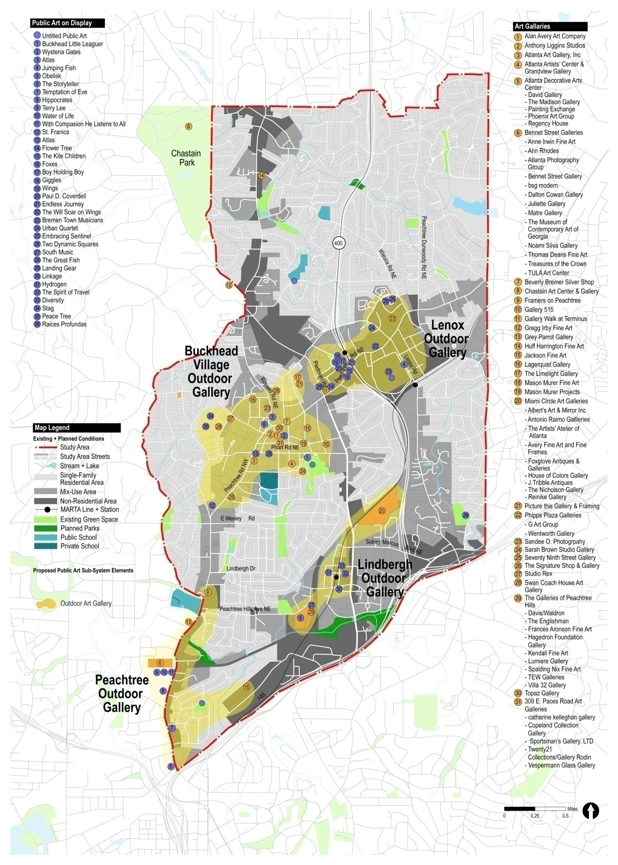
Mile Long Art Museum
Imagine a community that is home to 36 displays of public art, and more than 30 art galleries…sounds like a destination for art? It is and it has a name you know well - Buckhead
Livable Buckhead, Inc is working to leverage these assets by creating a network of public art anchored by Peachtree Road and tying together the Buckhead Collection – our system of parks.
The Walking Museum will begin with 20 monumental sculptures along Peachtree Road and expand from there to become the center for outdoor sculpture and art in Atlanta.

Slide 15
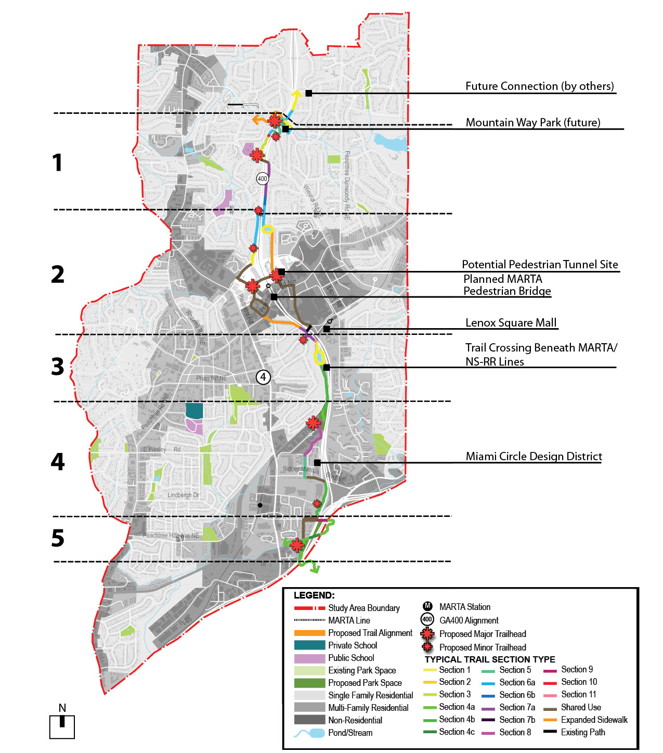
GA 400 Trail
Key Features
5.2 mile bike/walk trail
Limits – From Loridans Drive south
to Peachtree Creek
Connection to Sara Smith Elementary
Connection to City’s Oldest Cemetery
$10 million construction cost
Direct Connection to Beltline
Design Underway – March 2013
PATH Foundation Partner
Buckhead CID Partner
Spine of Buckhead Collection
~35% Funding Secured

Slide 16
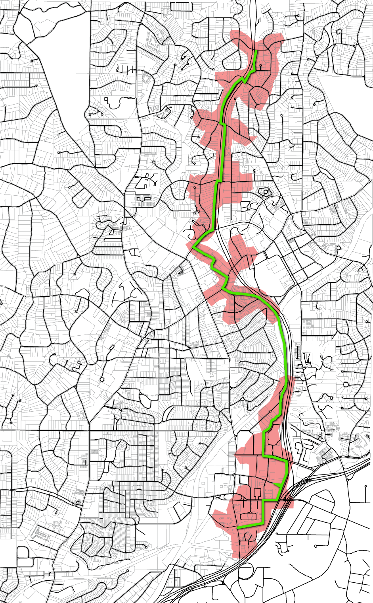
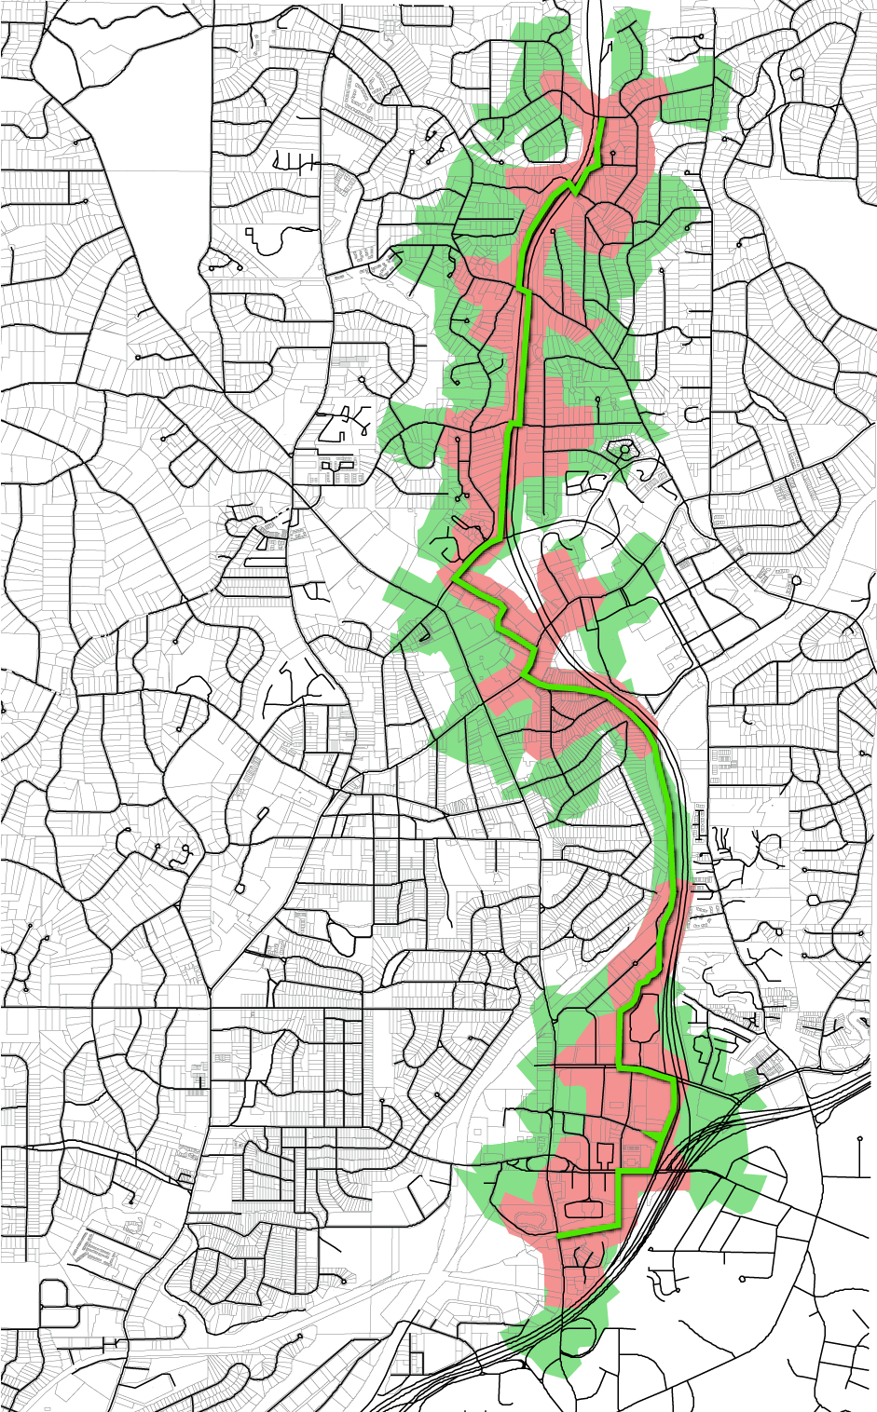
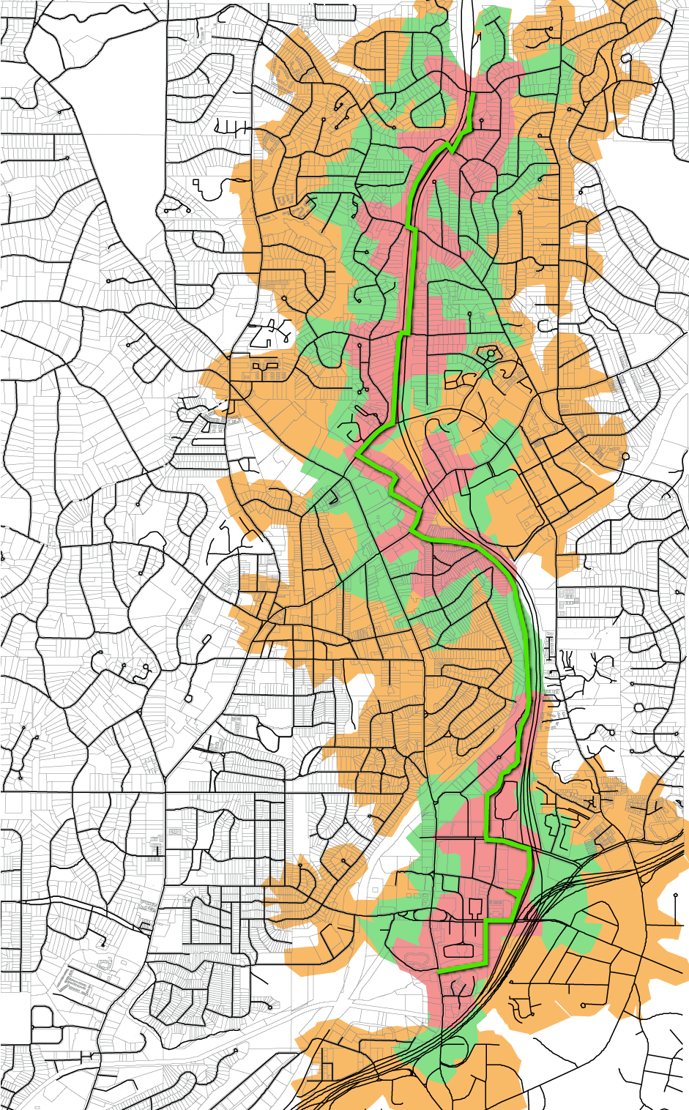
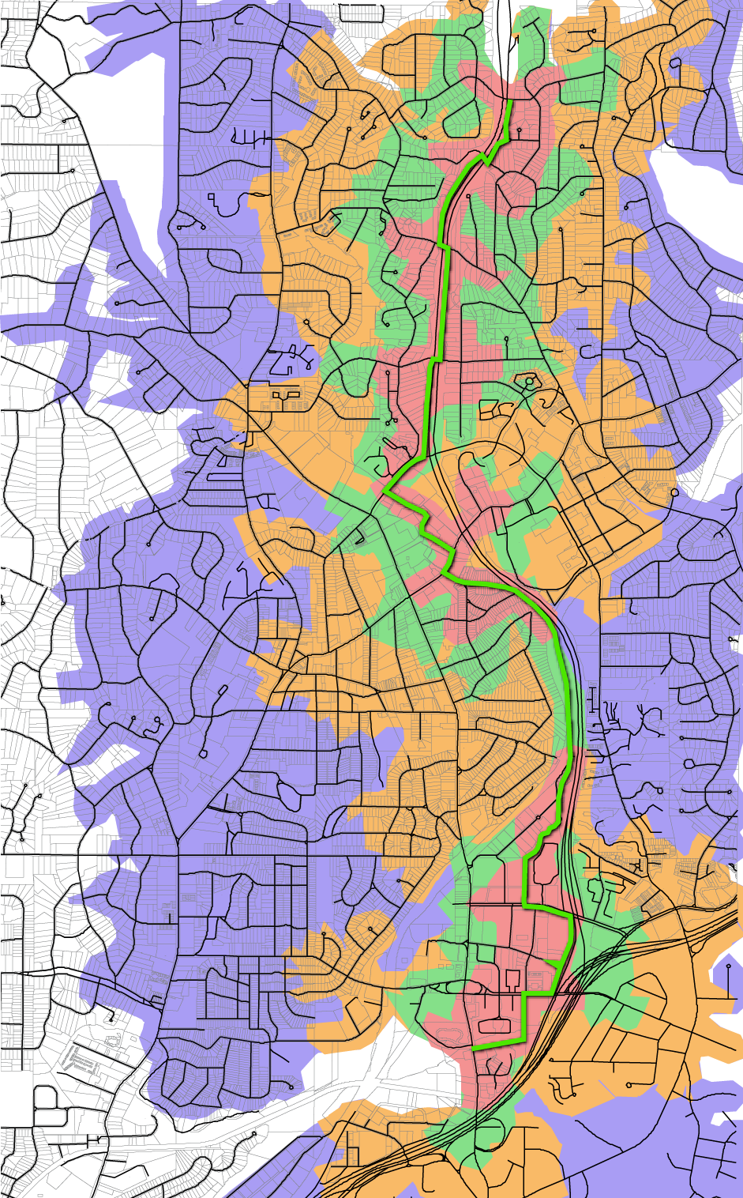
Potential Connectivity
5,133 residents within 5 minute walk
8,175 residents within 10 minute walk
16,519 residents within 5 minute bike ride
44,272 residents within 10 min bike ride

Slide 17
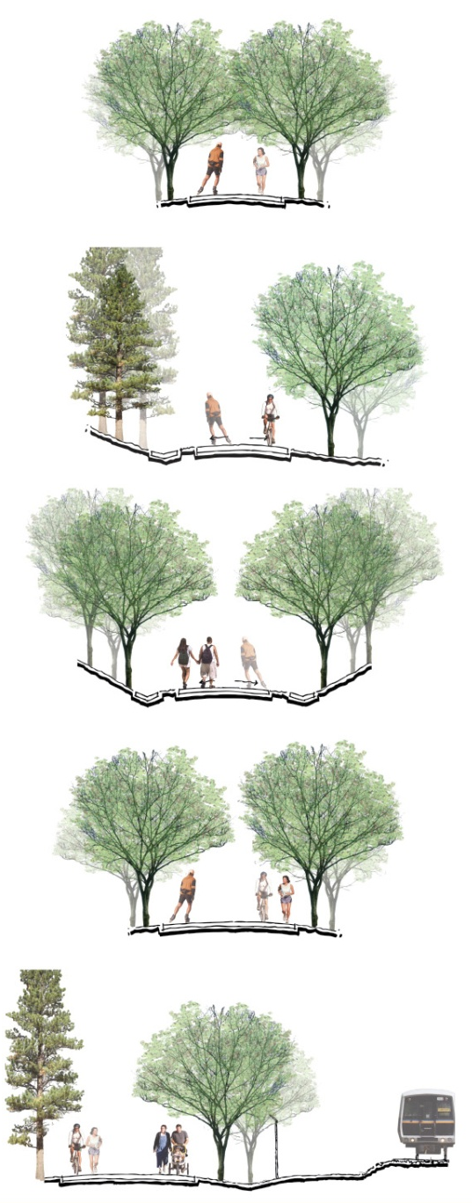
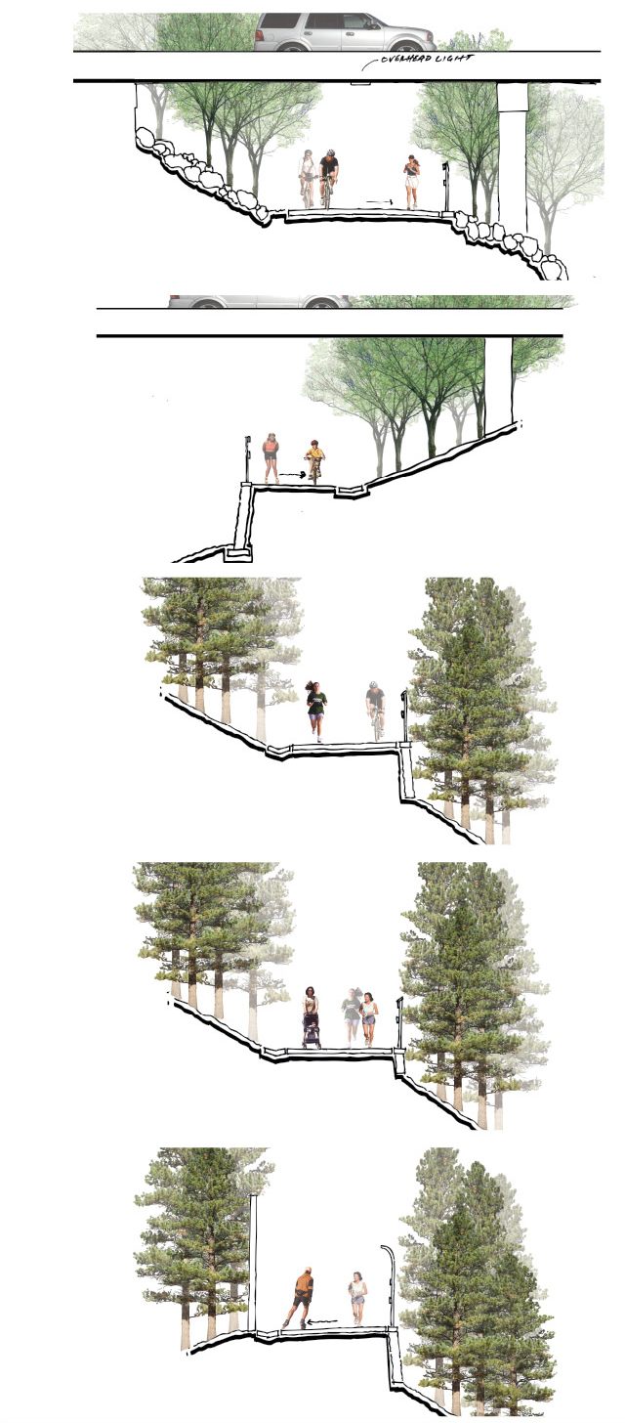
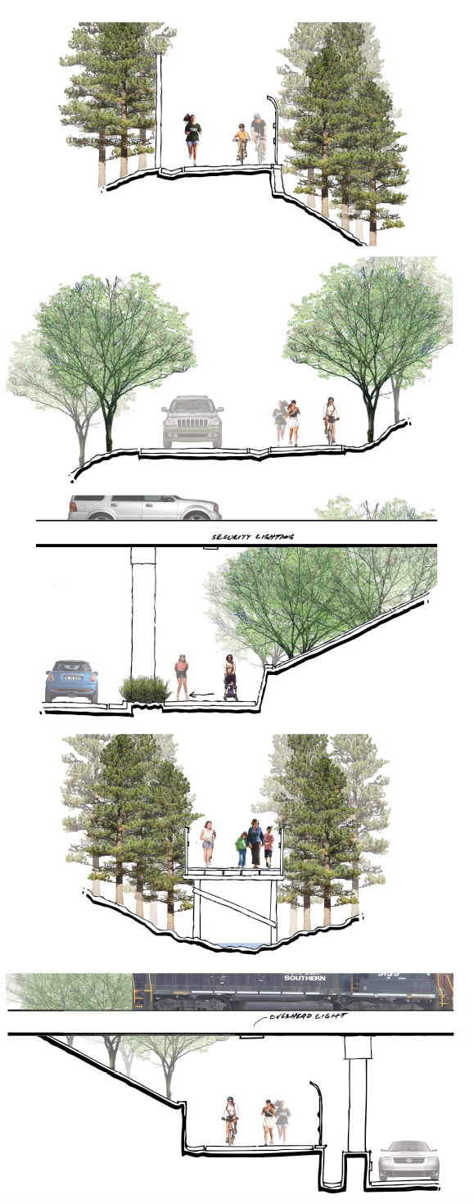
GA 400 Multi-Purpose Trail Types

Slide 18
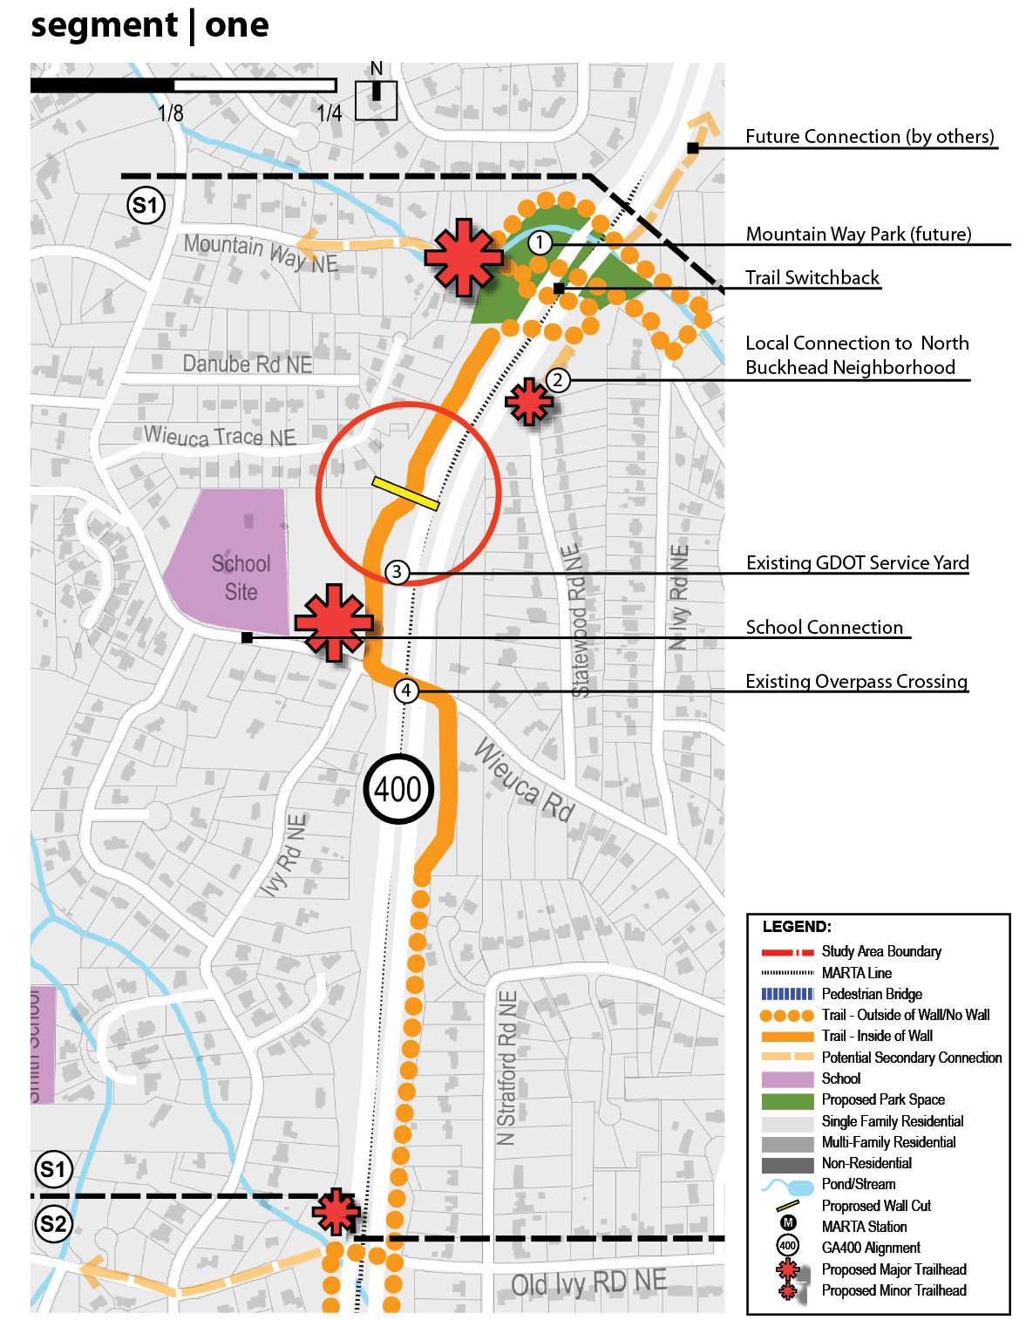
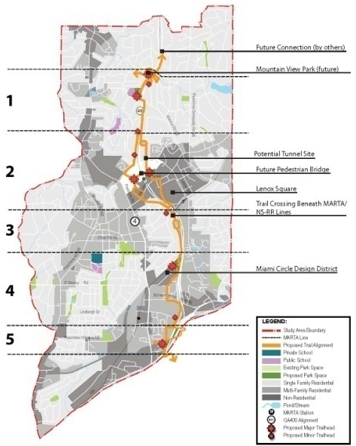
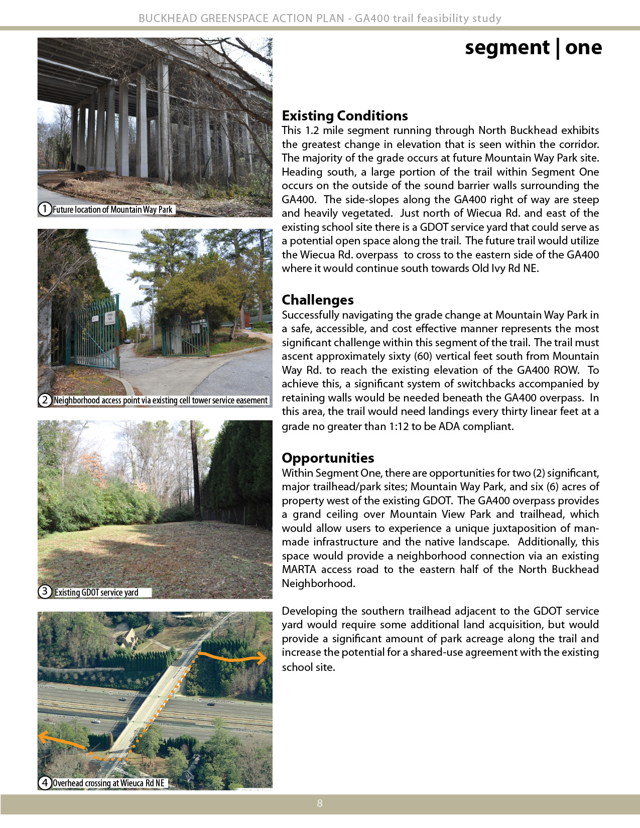
Segment One

Slide 19
Segment One

Slide 20
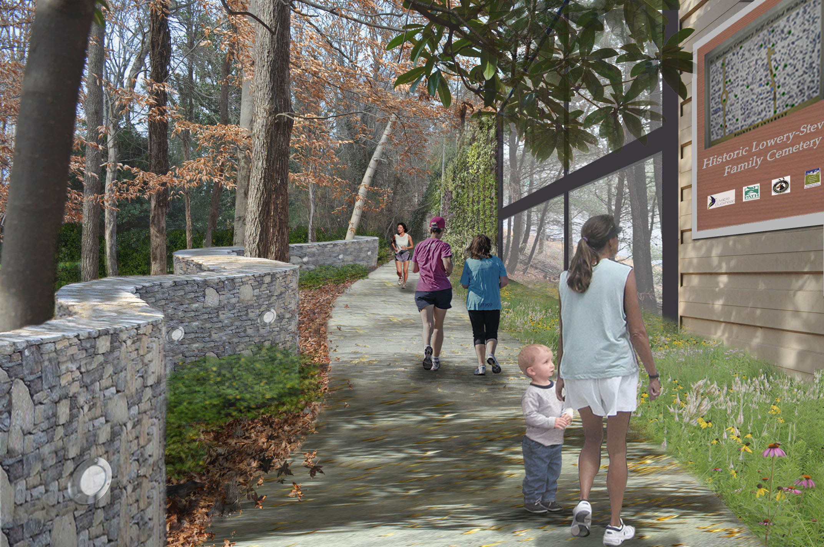

Slide 21
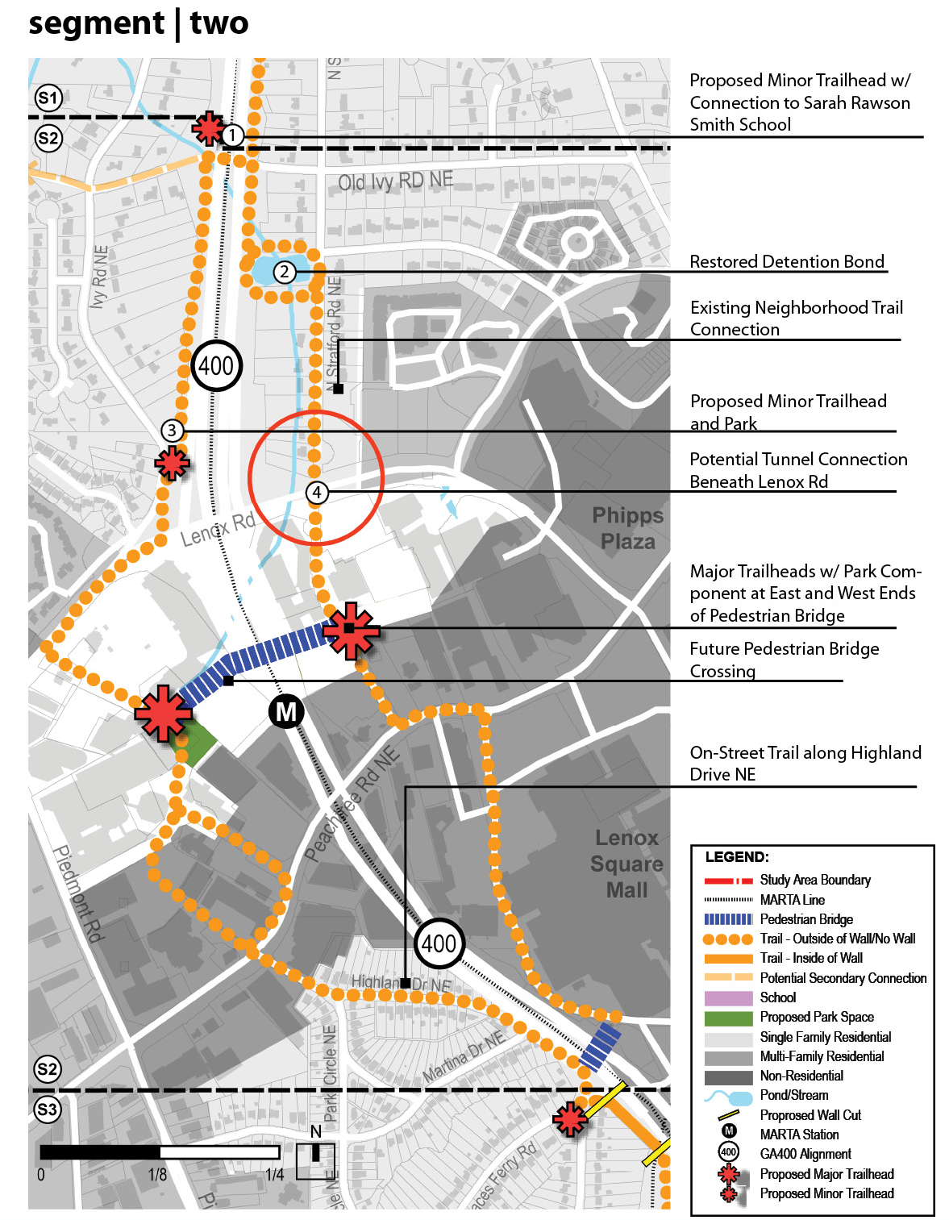
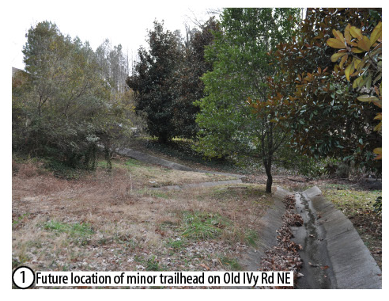
Segment Two

Slide 22
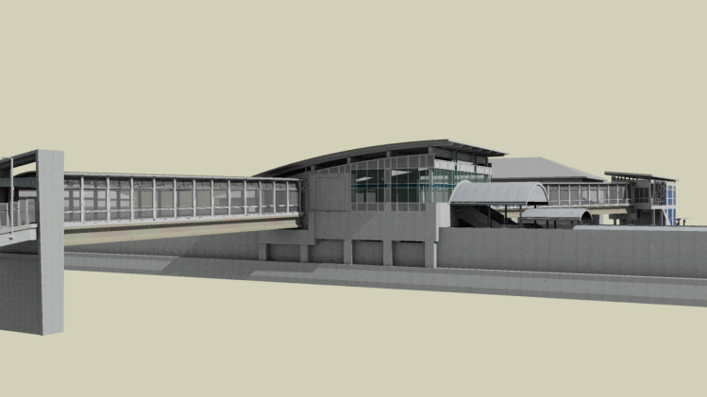
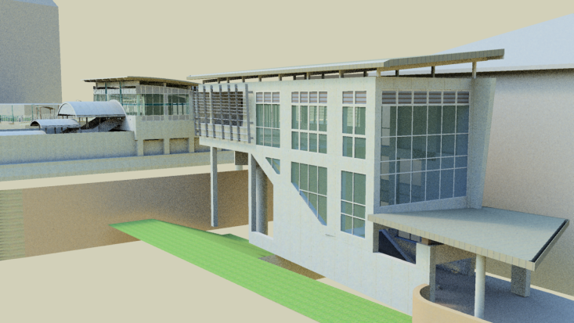
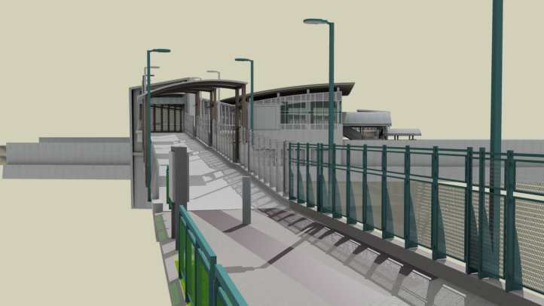
MARTA Bridge/
Tower Place Park

Slide 23
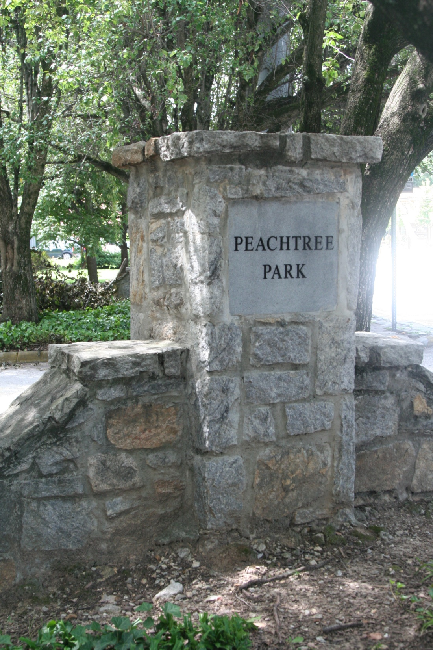
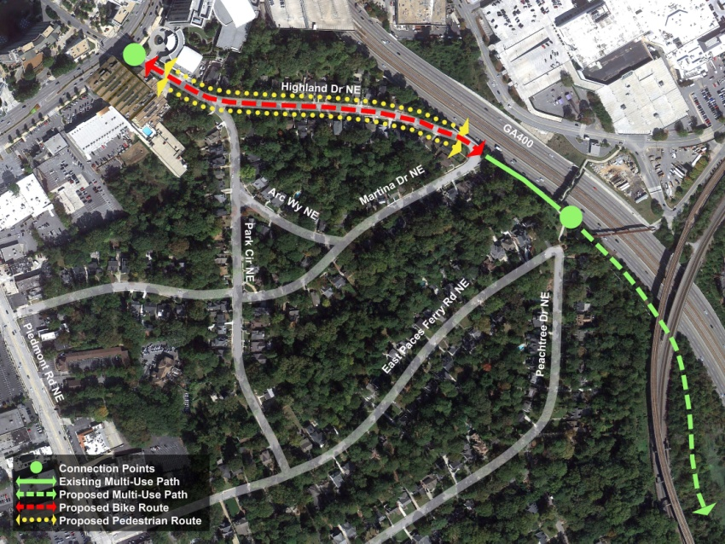
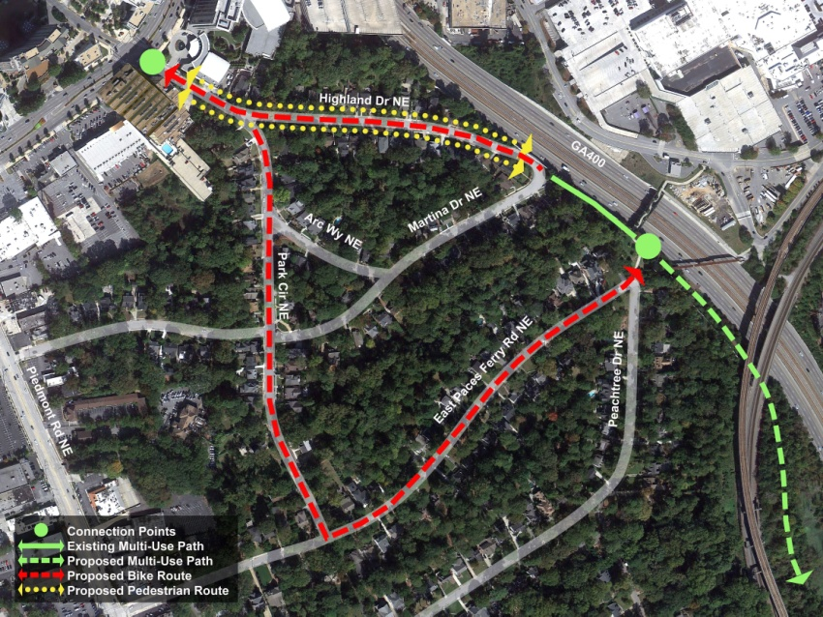
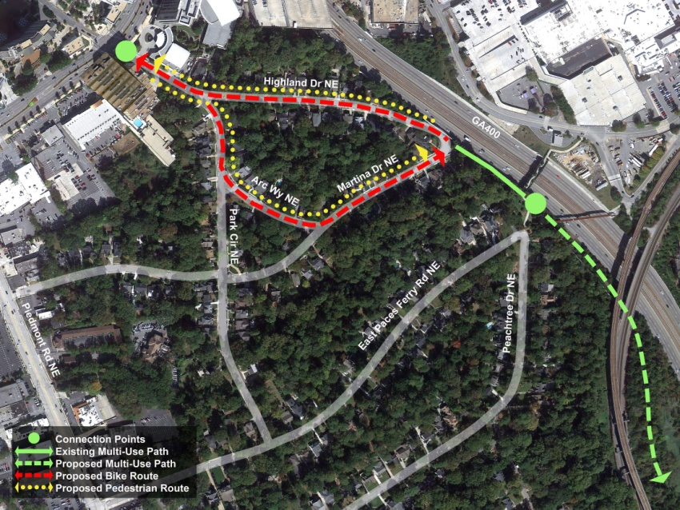
Peachtree Park

Slide 24
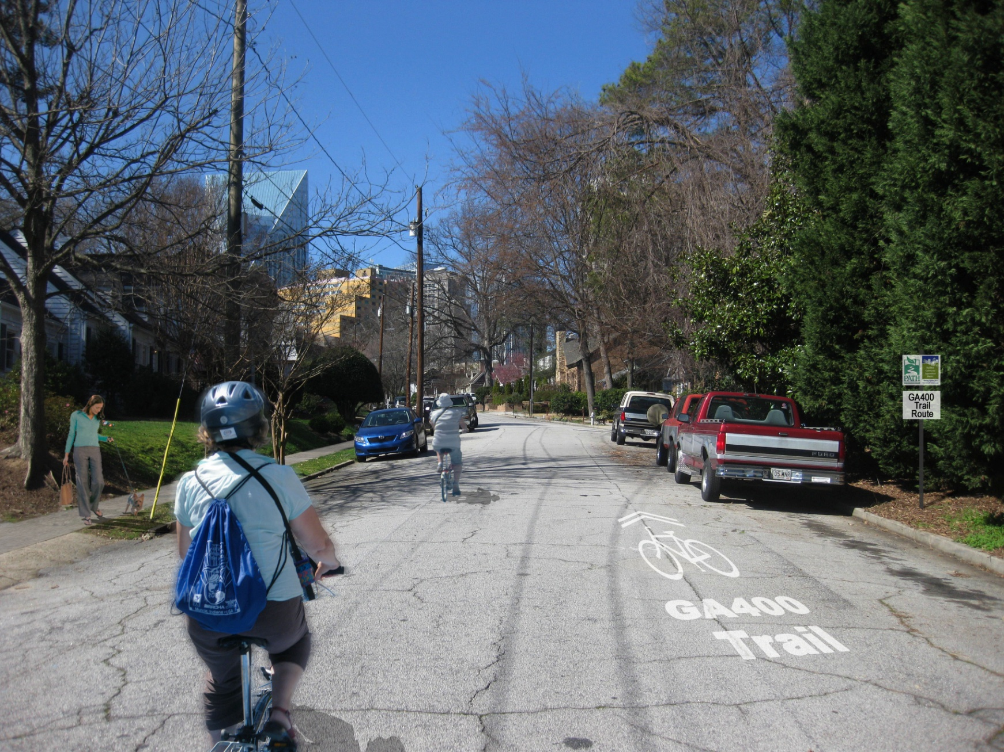
Design Ideas for Discussion | Alternative 2
Sidewalk Improvements + Trail Signage + Sharrow Markings

Slide 25
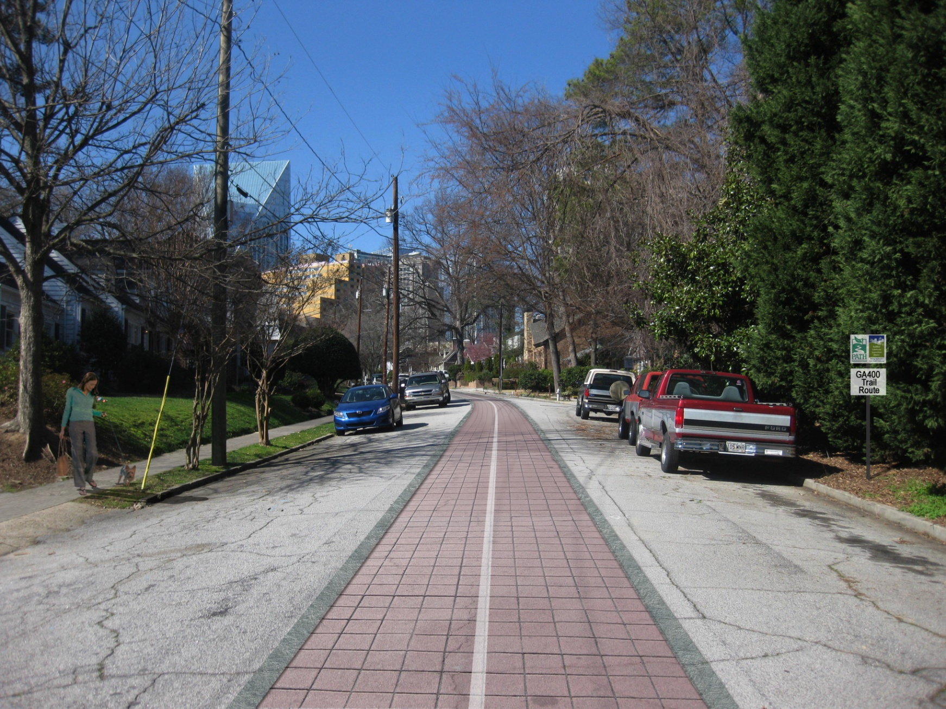
Preliminary Design Ideas for Discussion | Non-Traditional Alternative
Sidewalk Improvements + Bike Yield Street

Slide 26
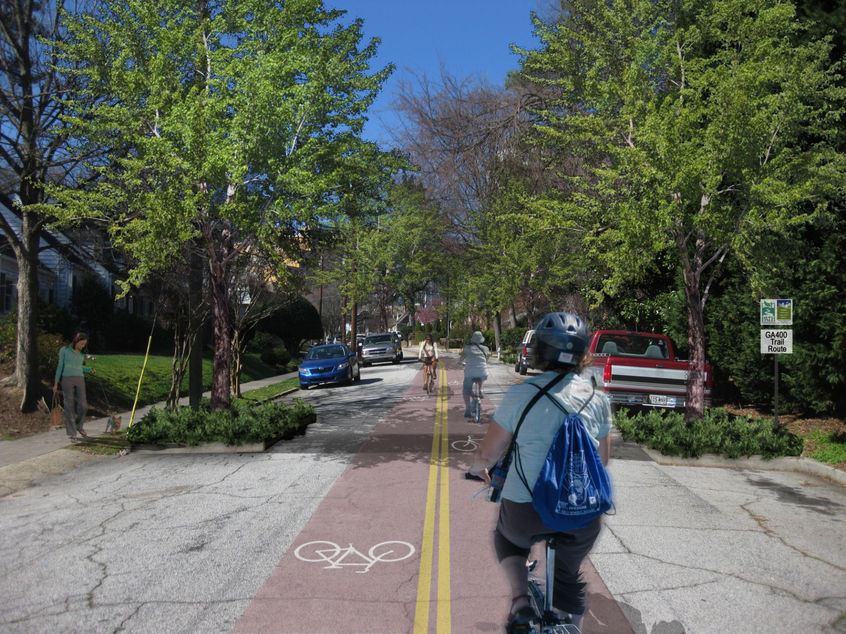
Design Ideas for Discussion | Alternative 1
Sidewalk Improvements + Cycle Street + Traffic Calming Enhancements
Sidewalk Improvements
Speed Cushions + Street Trees

Slide 27



Segment Three

Slide 28



Slide 29


Notes:
Looks at existing underutilized lands and creates opportunities for nature resource based recreation while protecting natural resources, promoting environmental education, improving water quality, etc.

Slide 30


Segment Four

Slide 31


Segment 4 – Miami Circle

Slide 32


Segment Five

Slide 33
GA400 Milestones
Concept Development 2010-2011
Agency Engagement 2011- 2012
Public Engagement 2012- ongoing
Preliminary Design Spring /Summer 2012
Final Design Fall 2012/Spring 2013
Permitting Spring 2013
Final Fundraising 2012-2013
Construction Fall 2013/early 2014

Slide 34
Membership Opportunities
Who Should Join?
Individual Residents ($50 - $500)
Civic Associations ($100 - $1,000)
Hoteliers ($500 - $2,000)
Corporations ($250 - $2,500)
Commercial Property Owners ($1000 - $8,000)
Strategic Partners ($1000 - $10,000)
Sustainable Products and Services Providers ($1,000 - $5,000)
Benefits of Joining
Monthly Newsletter, emailTraffic Alerts, Voting Eligibility, Company Spotlight in newsletter, discounted seminar participation, access to community demographics data, commuter services, leadership eligibility, negotiated contracts

Slide 35
Thank you BBA for your partnership
Contact Us:
404.842.2680
info@livablebuckhead.org

